Slide 1
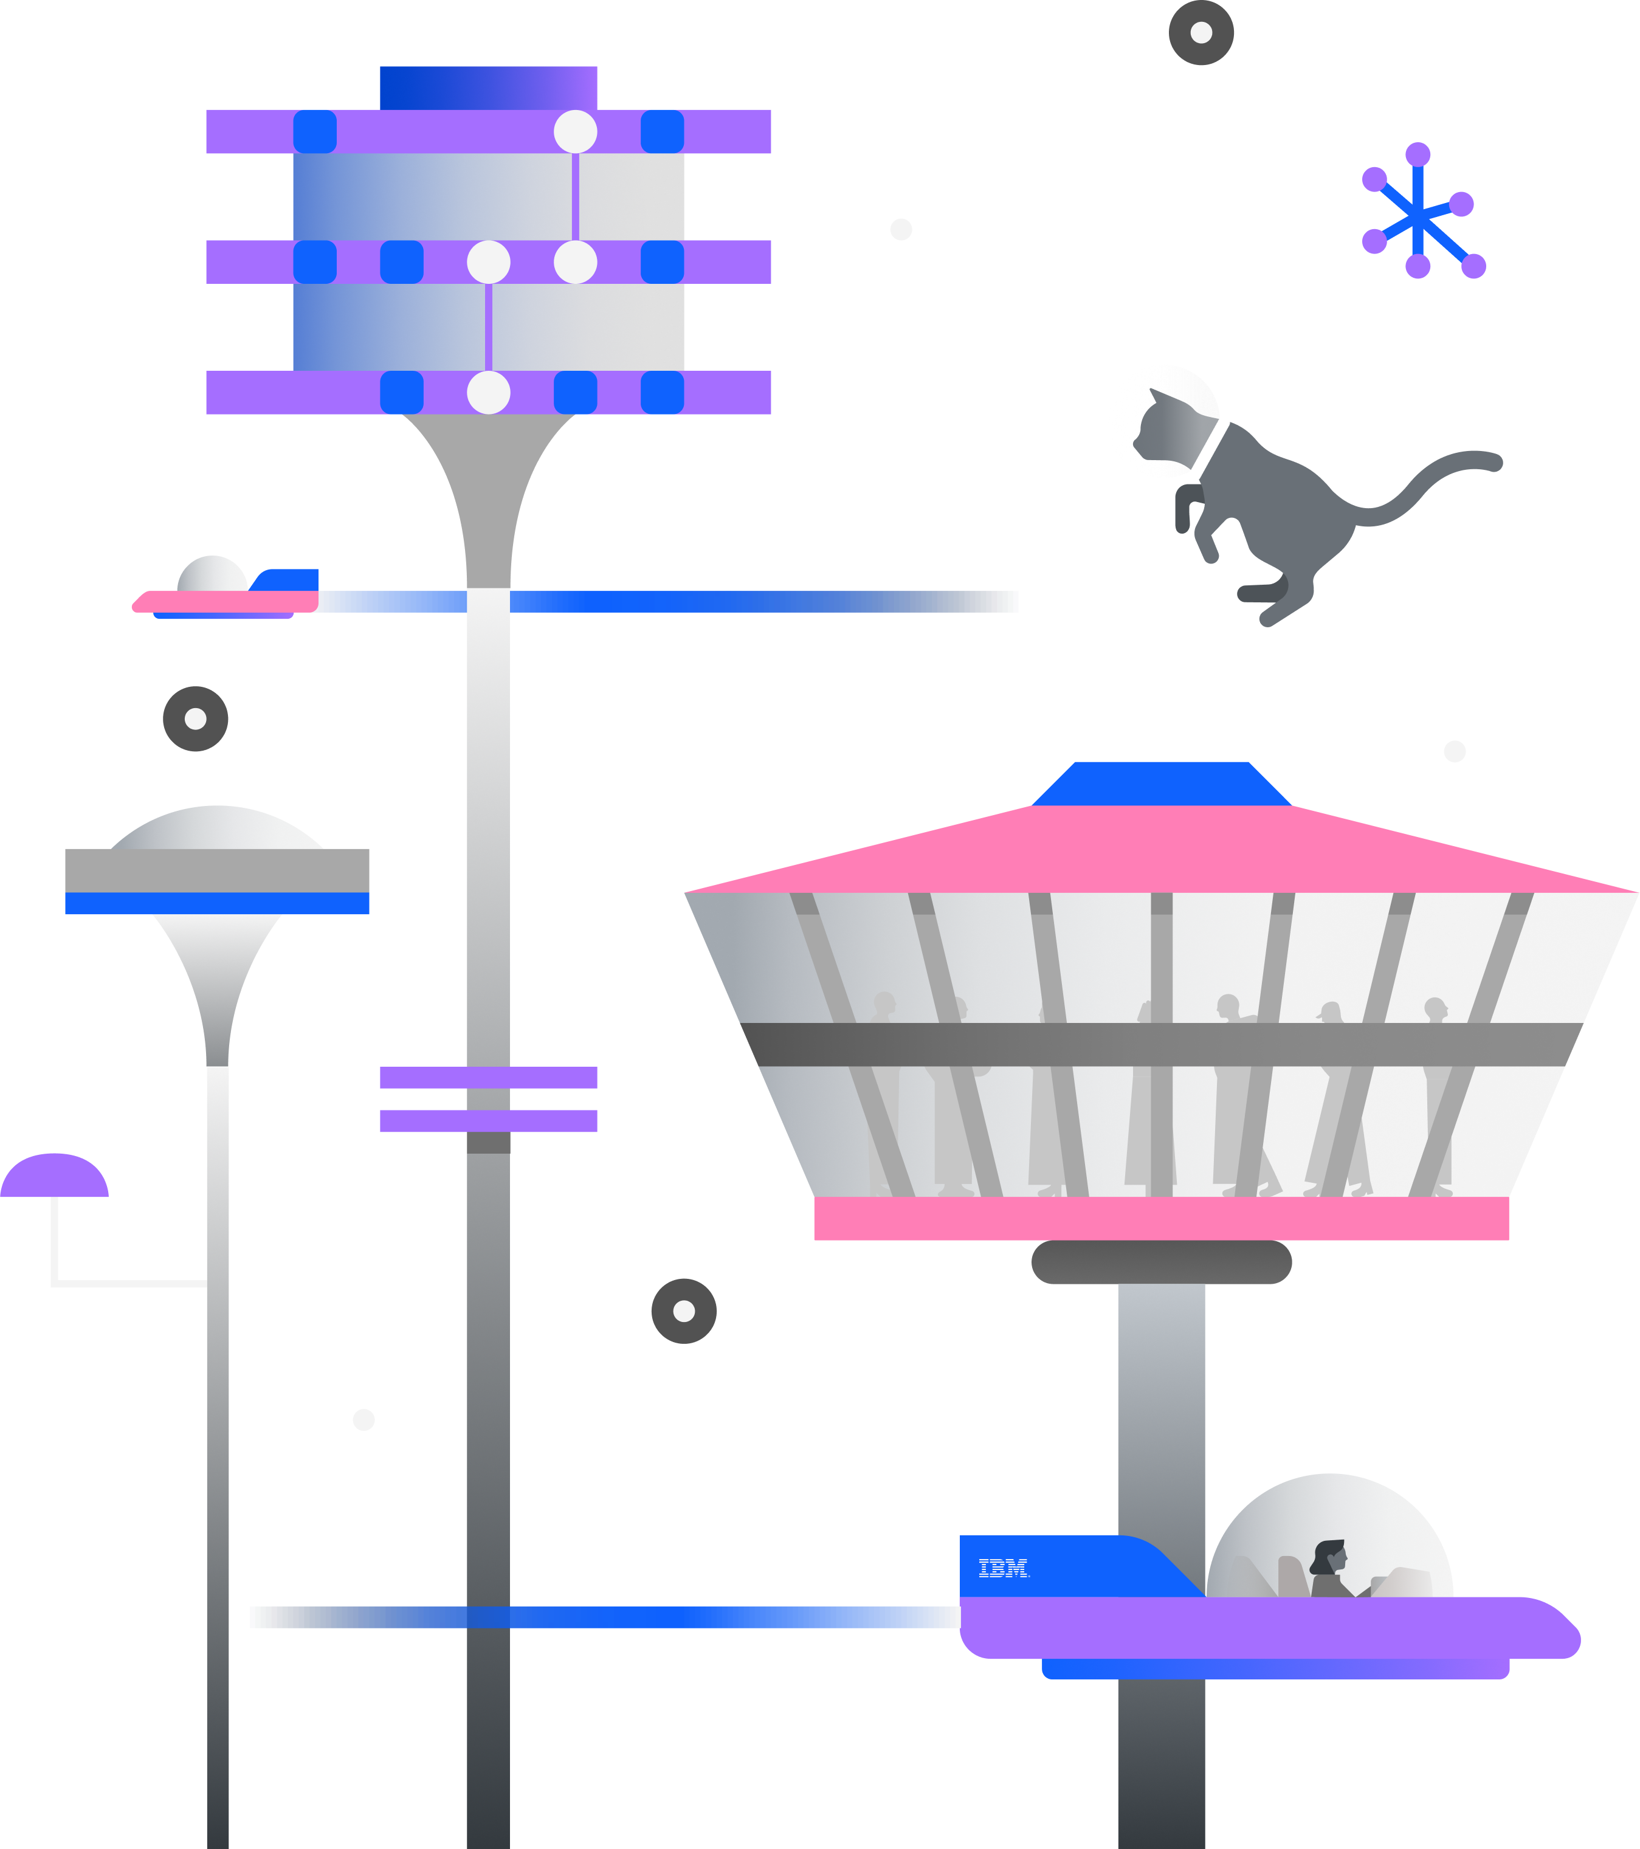
Welcome to the Qiskit Fall Fest 2024!

Slide 2
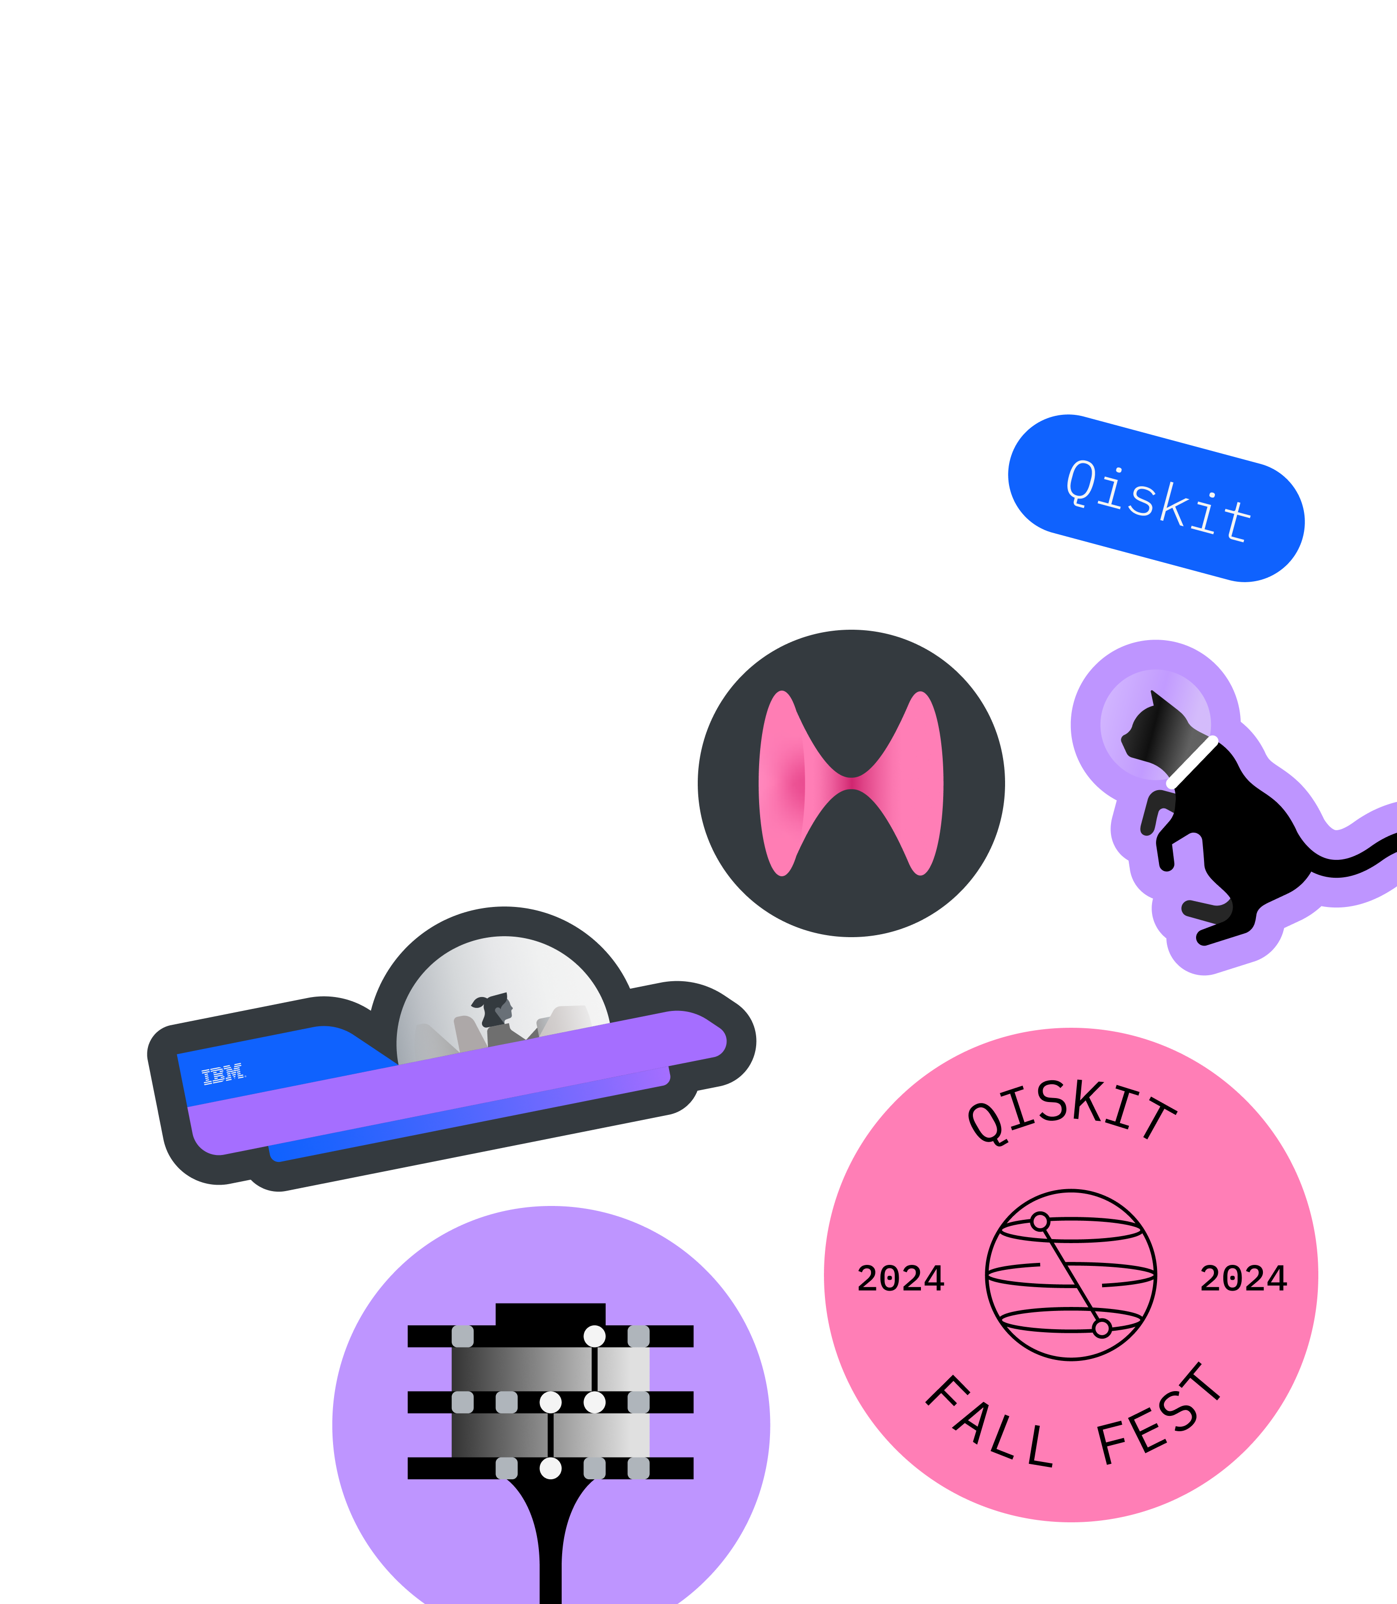
The Qiskit Fall Fest is a massive event, featuring thousands of students worldwide who are all learning about quantum computing and Qiskit. As part of the Qiskit Fall Fest, IBM Quantum has created a series of notebooks to work through, which all include coding challenges and Qiskit tutorials.
Qiskit Fall Fest 2024

Slide 3
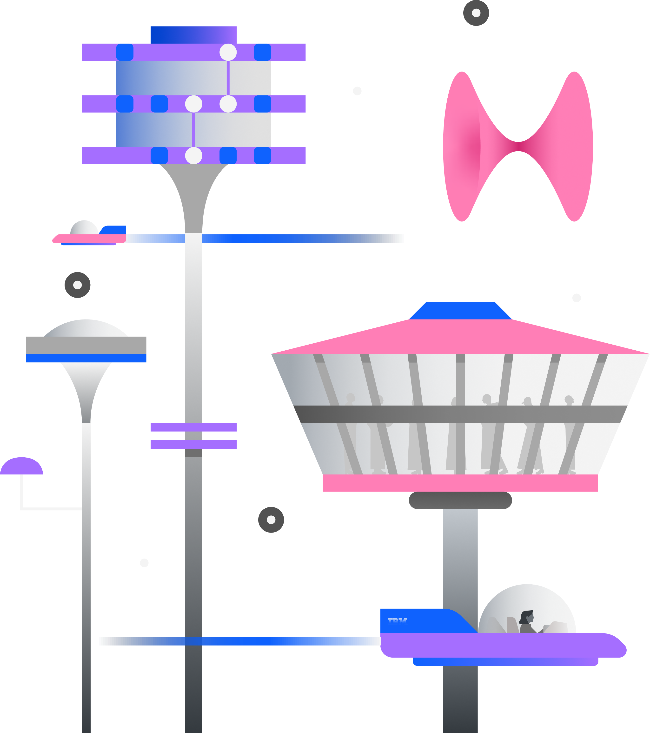
Graded Notebook 1: Welcome and Hello World
Qiskit Fall Fest 2024
Difficulty: 1/5
Estimated Time: 30 minutes

Slide 4

Qiskit Fall Fest 2024
CONTENTS
Qiskit
Install Qiskit
Troubleshoot
Configure your Challenge environment
Exercise 1
Generate a two-qubit Bell state using Qiskit patterns
Step 1: Map circuits and operators
Exercise 2
The grader cell
Step 2: Optimize the circuit
Step 3: Execute the circuit
Step 4: Post-process the results

Slide 5
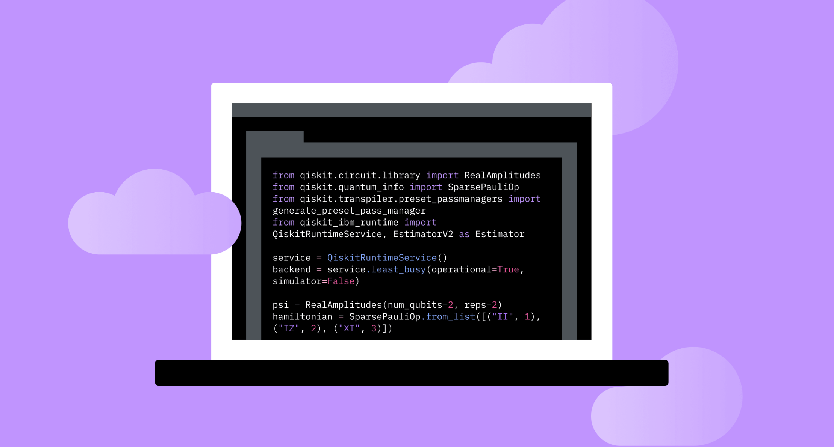







Qiskit
The Qiskit SDK which was launched in 2017 is the world's most popular software stack for quantum computing, with over 2,000 forks, over 8,000 contributions, and over 3 trillion circuits run.
Core Capabilities:
Tools for mapping problems to quantum circuits.
Facilitates execution and optimization of quantum tasks.
Qiskit Components:
Qiskit SDK: Builds and optimizes quantum circuits.
Qiskit Runtime Service: Orchestrates and runs quantum workloads.
Qiskit Transpiler Service: Optimizes quantum circuits for execution.

Slide 6

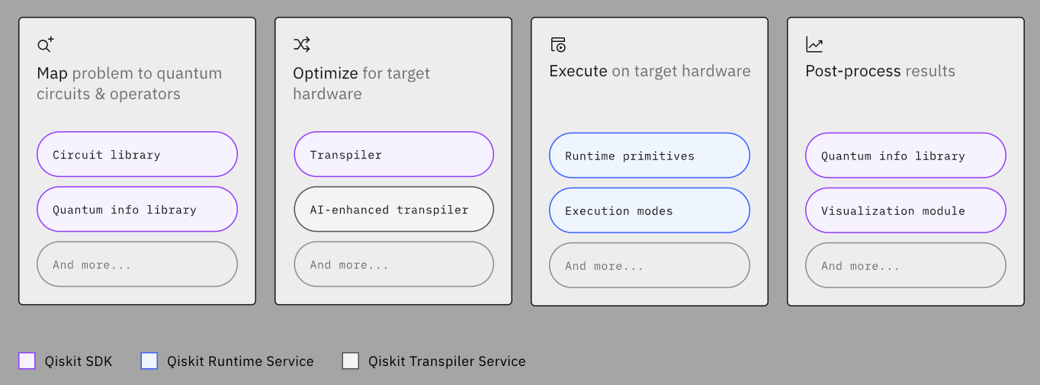
Steps involved in running a quantum circuit on real hardware – map, optimize, execute, and post-process
Simply put, Qiskit is software for doing real work on utility-scale quantum computers.

Slide 7





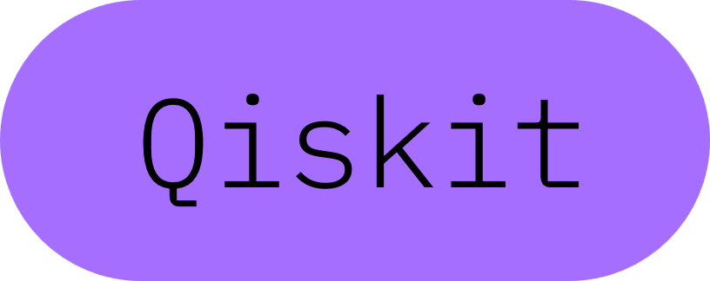

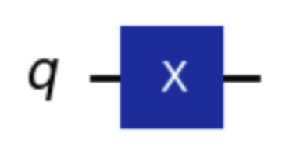
Install Qiskit
Install code for a cloud-based environment-
Code to create a basic quantum circuit-
%pip install qiskit[visualization]
from qiskit import QuantumCircuit # Create a new circuit with a single qubit qc = QuantumCircuit(1) # Add a Not gate to qubit 0 qc.x(0) # Return a drawing of the circuit using MatPlotLib ("mpl"). This is the # last line of the cell, so the drawing appears in the cell output. qc.draw("mpl")
OUTPUT

Slide 8
Troubleshoot
Install other required packages-
Check qiskit version-
Check other dependencies-
!pip install qiskit_aer !pip install qiskit_ibm_runtime !pip install matplotlib !pip install pylatexenc !pip install git+https://github.com/qiskit-community/Quantum-Challenge-Grader.git
#If you see a version lower than 1.2, you'll need to restart your kernel and re-run the code. import qiskit qiskit.__version__
**You may see this error at the end of installs:
`ERROR: pip's dependency resolver does not currently take into account all the packages that are installed.` It is safe to ignore that particular error.
# Your `qc-grader` should be version 0.19.0 or higher. !pip show pylatexenc matplotlib qc_grader

Slide 9
Configure your environment
Navigate to the [IBM QuantumPlatform] (https://quantum.ibm.com/)
Make sure you log in using the same email you registered for this event with.
Look to the top right corner, click and copy your API token.
In the code below, replace `deleteThisAndPasteYourTokenHere` with your token.
## Save your API token to track your progress #You do not need quotation marks around your API token! %set_env QXToken=deleteThisAndPasteYourTokenHere # Make sure there is no space between the equal sign and the beginning of your token

Slide 10
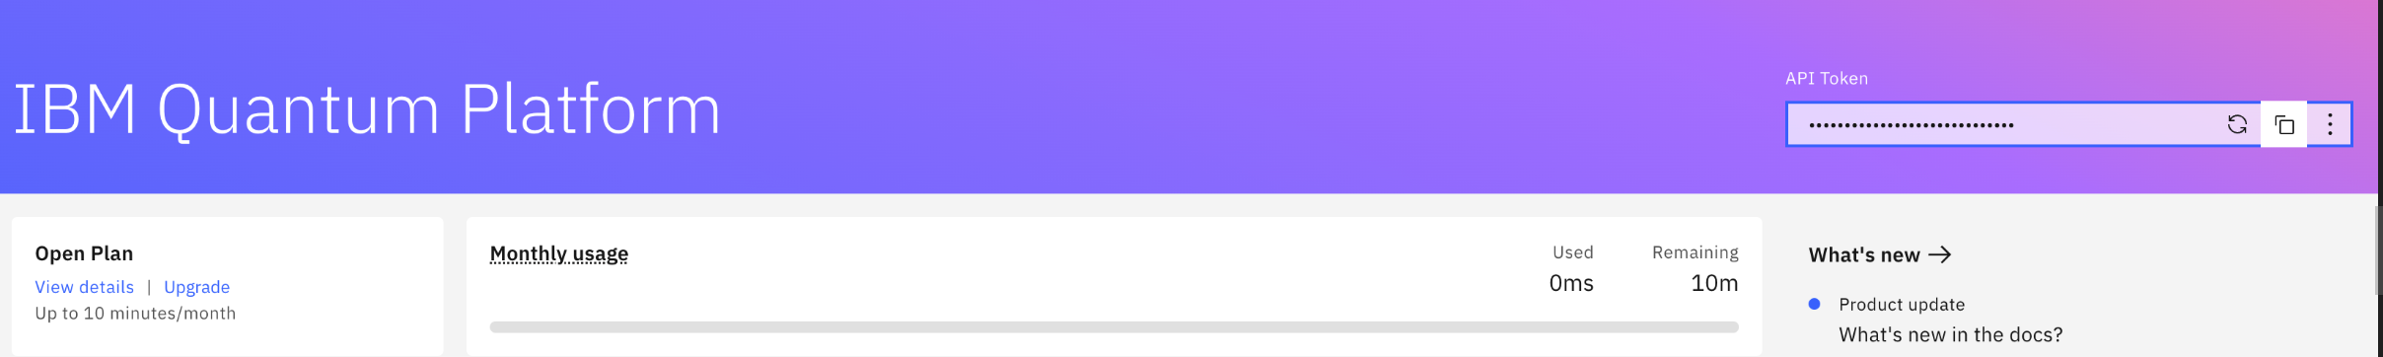
Configure your environment
You need to **store your API token** to track your progress. If you do not properly store your API token, the grader will not work.

Slide 11
Configure your environment
And finally, we will run all the required imports for the rest of the notebook. In the future, this will be done at the beginning of each notebook.
### Imports from qiskit import QuantumCircuit from qiskit.quantum_info import SparsePauliOp from qiskit_ibm_runtime import EstimatorV2 as Estimator from qiskit_aer import AerSimulator import matplotlib.pyplot as plt from qc_grader.challenges.fall_fest24 import grade_lab1_ex1, grade_lab1_welcome

Slide 12

Exercise 1: Testing the grader cell
Every exercise you encounter in the Qiskit Fall Fest is followed by a **grader cell**. The grader takes the code and passes it to a *hidden auto-grader*. It will simply tell you "right" or "wrong." However, for more complex exercises, we include hints or suggestions.
Your Task: Change the value of the variable `answer` to be a string. This string can be anything you like.
### Exercise Cell - this is where you add your own code to solve the question ### To pass the grader, the variable answer must be a "string" answer = 42
### Grader Cell - Submit your answer by running the following code ### You do not need to add any code into this cell grade_lab1_welcome(answer)

Slide 13
Potential fixes for some common errors
Error: `argument "answer" (int) is not an instance of str`
Solution: You need to change the value of the `answer` variable to be a string. A string is a word or sentence contained within quotation marks.
Error: `Failed: 401 Client Error: Unauthorized for url: https://auth.quantum.ibm.com/api/users/loginWithToken`
Solution: Return to the [Configure your challenge environment]
(#configure) section and properly store your API token
Error: `Failed: Unable to access service (Forbidden)`
Solution: You did not properly install your grader package. Restart your kernel and run all above code cells before returning here

Slide 14
Generate a two-qubit Bell state using Qiskit patterns
A Qiskit pattern is a four step workflow for setting up, running, and getting results from a quantum computer. This is the workflow designed to help you use utility-scale quantum computers. It works as follows:
Map circuits and operators
Optimize the circuit
Execute the circuit
Post-process the results

Slide 15
Qiskit pattern step 1: Map circuits and operators
Mapping your problem to circuits and operators is easy when you're only dealing with a handful of qubits but can get more difficult as you scale up. To start, we will construct a Bell state. This is a classic example that showcases entanglement between two qubits.
# Create a new circuit with two qubits qc = QuantumCircuit(2) # Add a Hadamard gate to qubit 0 placing it in a superposition qc.h(0) # Perform a CNOT gate on qubit 1, controlled by qubit 0. The CNOT effectively entangles our qubits. qc.cx(0, 1) # Return a drawing of the circuit using MatPlotLib ("mpl"). This is the # last line of the cell, so the drawing appears in the cell output. qc.draw("mpl")

Slide 16

Qiskit pattern step 1: Map circuits and operators
Visualizing Quantum Circuits with Operators-
Operators help verify that our quantum circuit behaves as expected.
Two types of operators:
Single-qubit operators: Measure one qubit (e.g., XI, IX, ZI, IZ).
Two-qubit operators: Measure both qubits (e.g., XX, ZZ).
Expectation values for the entangled bell state:
Single-qubit operators should have an expectation value of 0.
Two-qubit operators should have a non-zero value (ideally close to 1).
Gate Combinations:
Use X, Z, and Identity I gates to create operators.
I gate: does nothing to the qubit, useful for combining with X and Z.

Slide 17
Exercise 2:Operators
Your Task: Following the same approach, create the last three operators: `IZ`, `XX`, and `XI`.
# The ZZ applies a Z operator on qubit 0, and a Z operator on qubit 1 ZZ = SparsePauliOp('ZZ') # The ZI applies a Z operator on qubit 0, and an Identity operator on qubit 1 ZI = SparsePauliOp('ZI') # The IX applies an Identity operator on qubit 0, and an X operator on qubit 1 IX = SparsePauliOp('IX') ### Write your code below here ### ### Follow the same naming convention we used above ## Don't change any code past this line, but remember to run the cell. observables = [IZ, IX, ZI, XI, ZZ, XX]

Slide 18
Potential fixes for some common errors
# Submit your answer using following code
grade_lab1_ex1(observables)
Error: `NameError: name 'observables' is not defined`
Solution: You need to run the code cell in Exercise 2 prior to running the Grader cell
Error:`item 0 of argument "observables" (list) is not an instance of qiskit.quantum_info.operators.symplectic.pauli.Pauli`
Solution: The answers you provided were not Pauli objects. Revise your answer.

Slide 19

Qiskit pattern step 2: Optimize the circuit
A Qiskit pattern is the best framework for working with a quantum computer at *utility scale* — the point where quantum computers can perform reliable computations at a scale beyond brute force classical computing methods. These computations can use hundreds of qubits.
However, in this intro section, we're only using two qubits. So, that means we do not need to do any work here to optimize the circuit.
To optimize the circuit, we can use the Qiskit transpiler. During transpilation, we can optimally layout our qubits to minimize the required number of gates, for example.

Slide 20
Qiskit pattern step 3: Execute the circuit
Here we run our circuit using the Estimator which is a part of the Qiskit Runtime, then save the results as the variable `job`.
# Set up the Estimator estimator = Estimator(AerSimulator()) # Submit the circuit to Estimator pub = (qc, observables) job = estimator.run(pubs=[pub])

Slide 21
Qiskit pattern step 4: Post-process the results
The last step of Qiskit patterns is where we process, analyze, and visualize the results of our job. Here we are going to collect our data and plot it on a graph we construct.
# Collect the data data = ['IZ', 'IX', 'ZI', 'XI', 'ZZ', 'XX'] values = job.result()[0].data.evs # Set up our graph container = plt.plot(data, values, '-o') # Label each axis plt.xlabel('Observables') plt.ylabel('Values') # Draw the final graph plt.show()

Slide 22
Qiskit Fall Fest 2024
SUMMARY
Followed the Qiskit workflow to: Set up, optimize, run, and process circuits.
Created and validated a two-qubit Bell state.
Visualized operators to confirm proper entanglement.
Learned how to use the auto-grader to check results.

Slide 23
Thank you!

